Slide 1
AI Privacy and Policy and AI Application in Agriculture
Group 6
CLINTON ODUOR SCT221-0218/2017
DENNIS WANGONDU SCT221-0098/2017
HOPE ARGANE SCT221-0101/2017
DIANA IMINZA SCT221-0125/2017

Slide 2
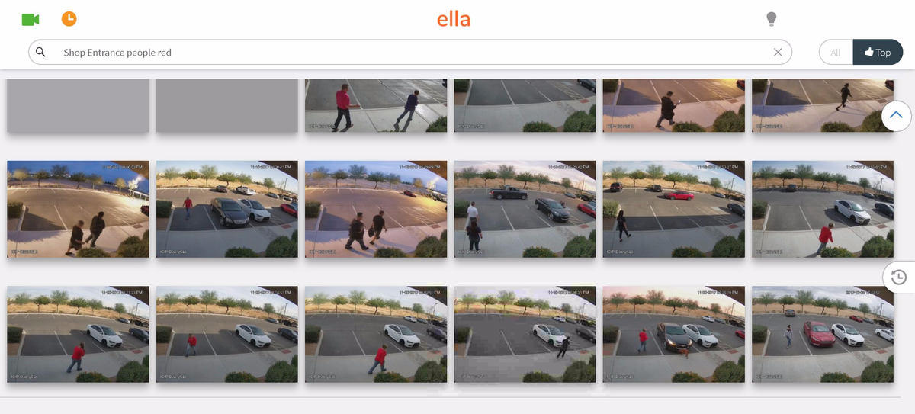
AI Privacy Concerns
Facial recognition and voice identification systems eg. Jitambulishe on Safaricom can track our movement in the real world. Ella runs on Google Cloud and can search footage from pretty much any CCTV system .
Smart home devices, motion sensing lights continuously collect data when we come and go.
AI uses large databases to store data. Without proper protection using the available privacy policies, unauthorized personnel can mine the data illegally and use it for marketing, blackmailing etc.

Slide 3
Components of AI privacy policies
AI systems should be transparent.
AI should have a “deeply rooted” right to the information it is collecting.
Consumers must be able to opt out of the system.
The data collected and the purpose of the AI must be limited by design.
Data must be deleted upon consumer request.

Slide 4
Available solutions
Homomorphic encryption – allows encrypted data that users send to the cloud to analyzed without having to decrypt it first and the results of the analysis are also encrypted. That way only the customer and not even the cloud service provider knows what information is contained in the data and the results of the analysis.
Differential privacy – ensures that when AI systems are learning from sensitive data, they are only learning what they are supposed to learn and not accidentally learning what they are not supposed to learn from the data.
Federated learning- is a machine learning technique that trains an algorithm across multiple decentralized edge devices or servers holding local data samples without exchanging their data samples.

Slide 5
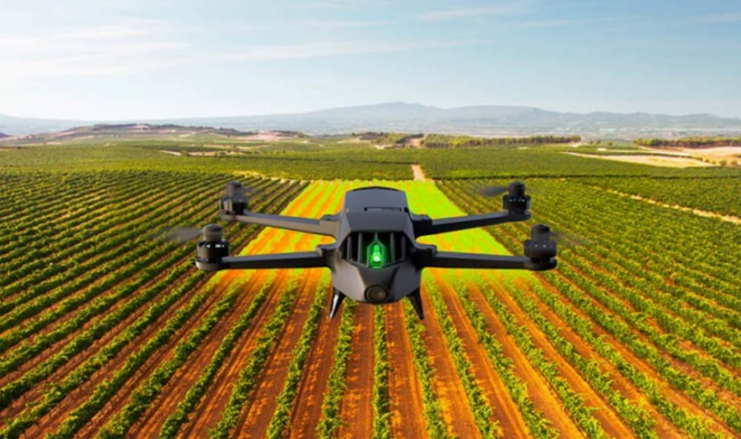
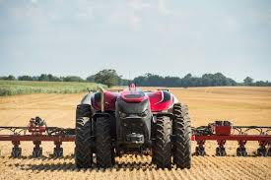
AI APPLICATIONS IN AGRICULTURE
Agriculture Robotics – Companies are developing and programming autonomous robots to handle essential agricultural tasks such as harvesting and weed control.
Crop, Soil and Livestock monitoring – companies are using computer vision and deep-learning algorithms to process data captured by drones or software based technology to monitor crops, soil and livestock.
Predictive Analytics – Machine learning models are being developed to track and predict various environmental impacts on crop yield such as Weather changes.

Slide 6
PREDICTIVE ANALYSIS
While using the machine learning algorithms in connection with images captured by satellites and drones, AI-enabled technologies predict weather conditions, analyses crop sustainability and evaluate farms for the presence of diseases or pests and poor plant nutrition on farms with data like temperature, precipitation, wind speed and solar radiation.
For example Farm Shots aims to detect diseases, pests and poor plant nutrition on farms.
aWhere predicts weather, analyze crop sustainability and evaluate farms for the presence of diseases and pests.

Slide 7
REFERENCES
Forbes Insights: Rethinking Privacy For The AI Era. (2020). Retrieved 11 February 2020, from https://www.forbes.com/sites/insights intelai/2019/03/27/rethinking-privacy-for-the-ai-era/#394a97f37f0a
Kerry, C. (2020). Protecting privacy in an AI-driven world. Retrieved 13 February 2020, from https://www.brookings.edu/research/protecting privacy-in-an-ai driven-world/
Sennaar, K. (2020). AI in Agriculture – Present Applications and Impact | Emerj. Retrieved 11 February 2020, from https://emerj.com/ai-sector-overviews/ai agriculture-present-applications-impact/

